Slide 1
E-Filing of Fictitious Business Name Statements
By: Kammi Foote, Inyo County Clerk/Recorder & Registrar of Voters

Slide 2
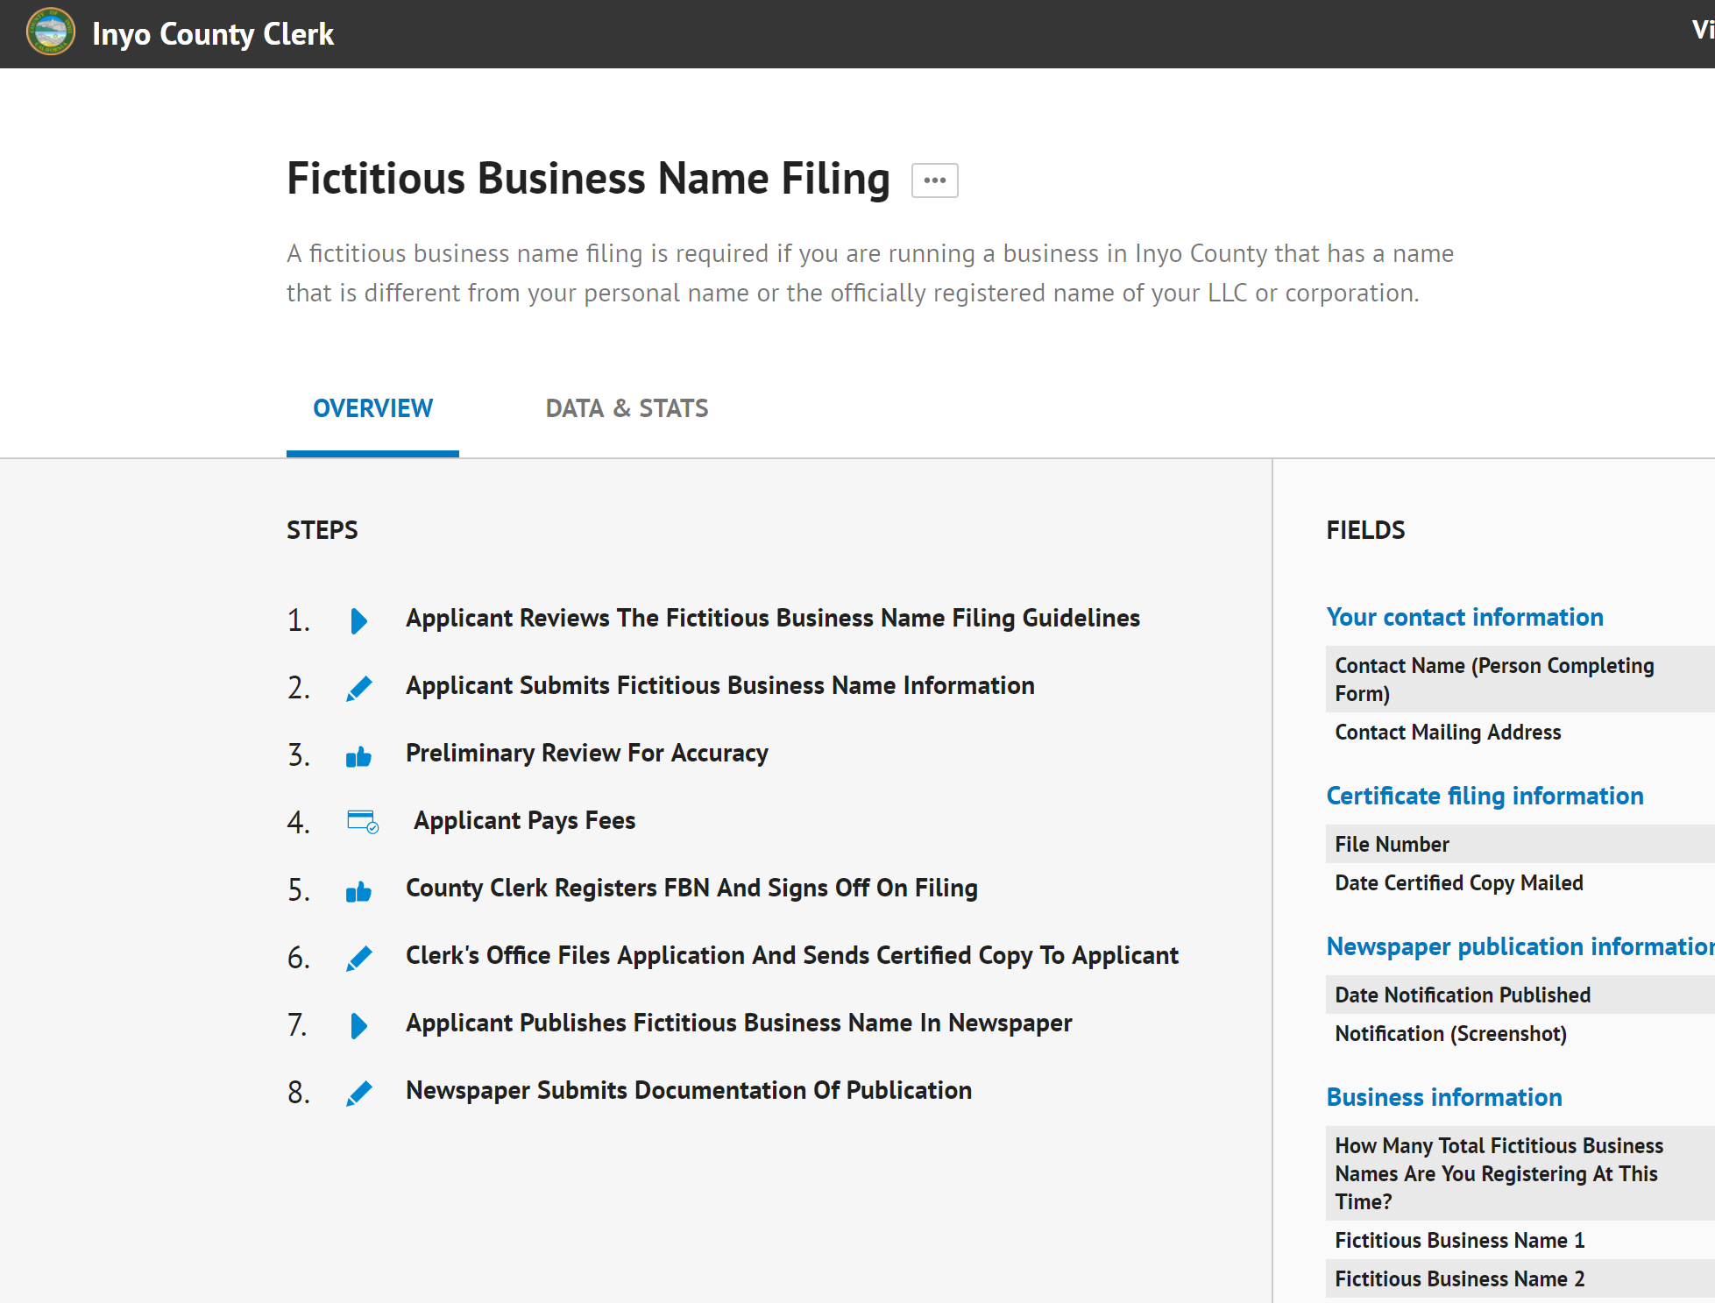
Process overview

Slide 3
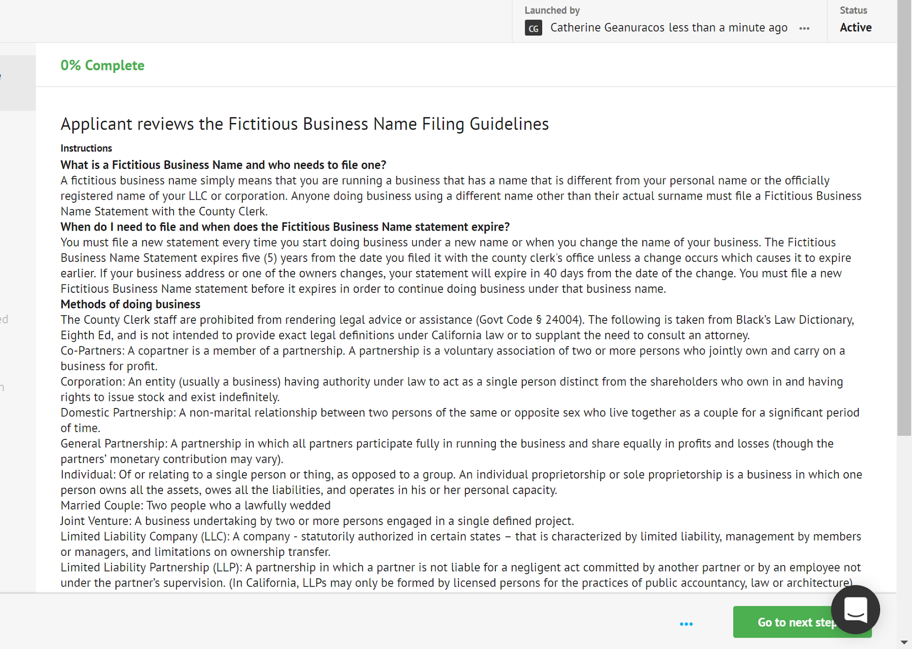
Applicant reviews Guidelines

Slide 4
Applicant adds data

Slide 5
Attestation

Slide 6
Confirmation

Slide 7
E-signature of filer

Slide 8
Fee payment
Amount is automatically calculated

Slide 9
Email notification of payment
Sent to Clerk’s office, Finance

Slide 10
Clerk reviews/files

Slide 11
Proof of Publication
Uploaded directly by newspaper

Slide 12
Process is complete
Online summary

Slide 13
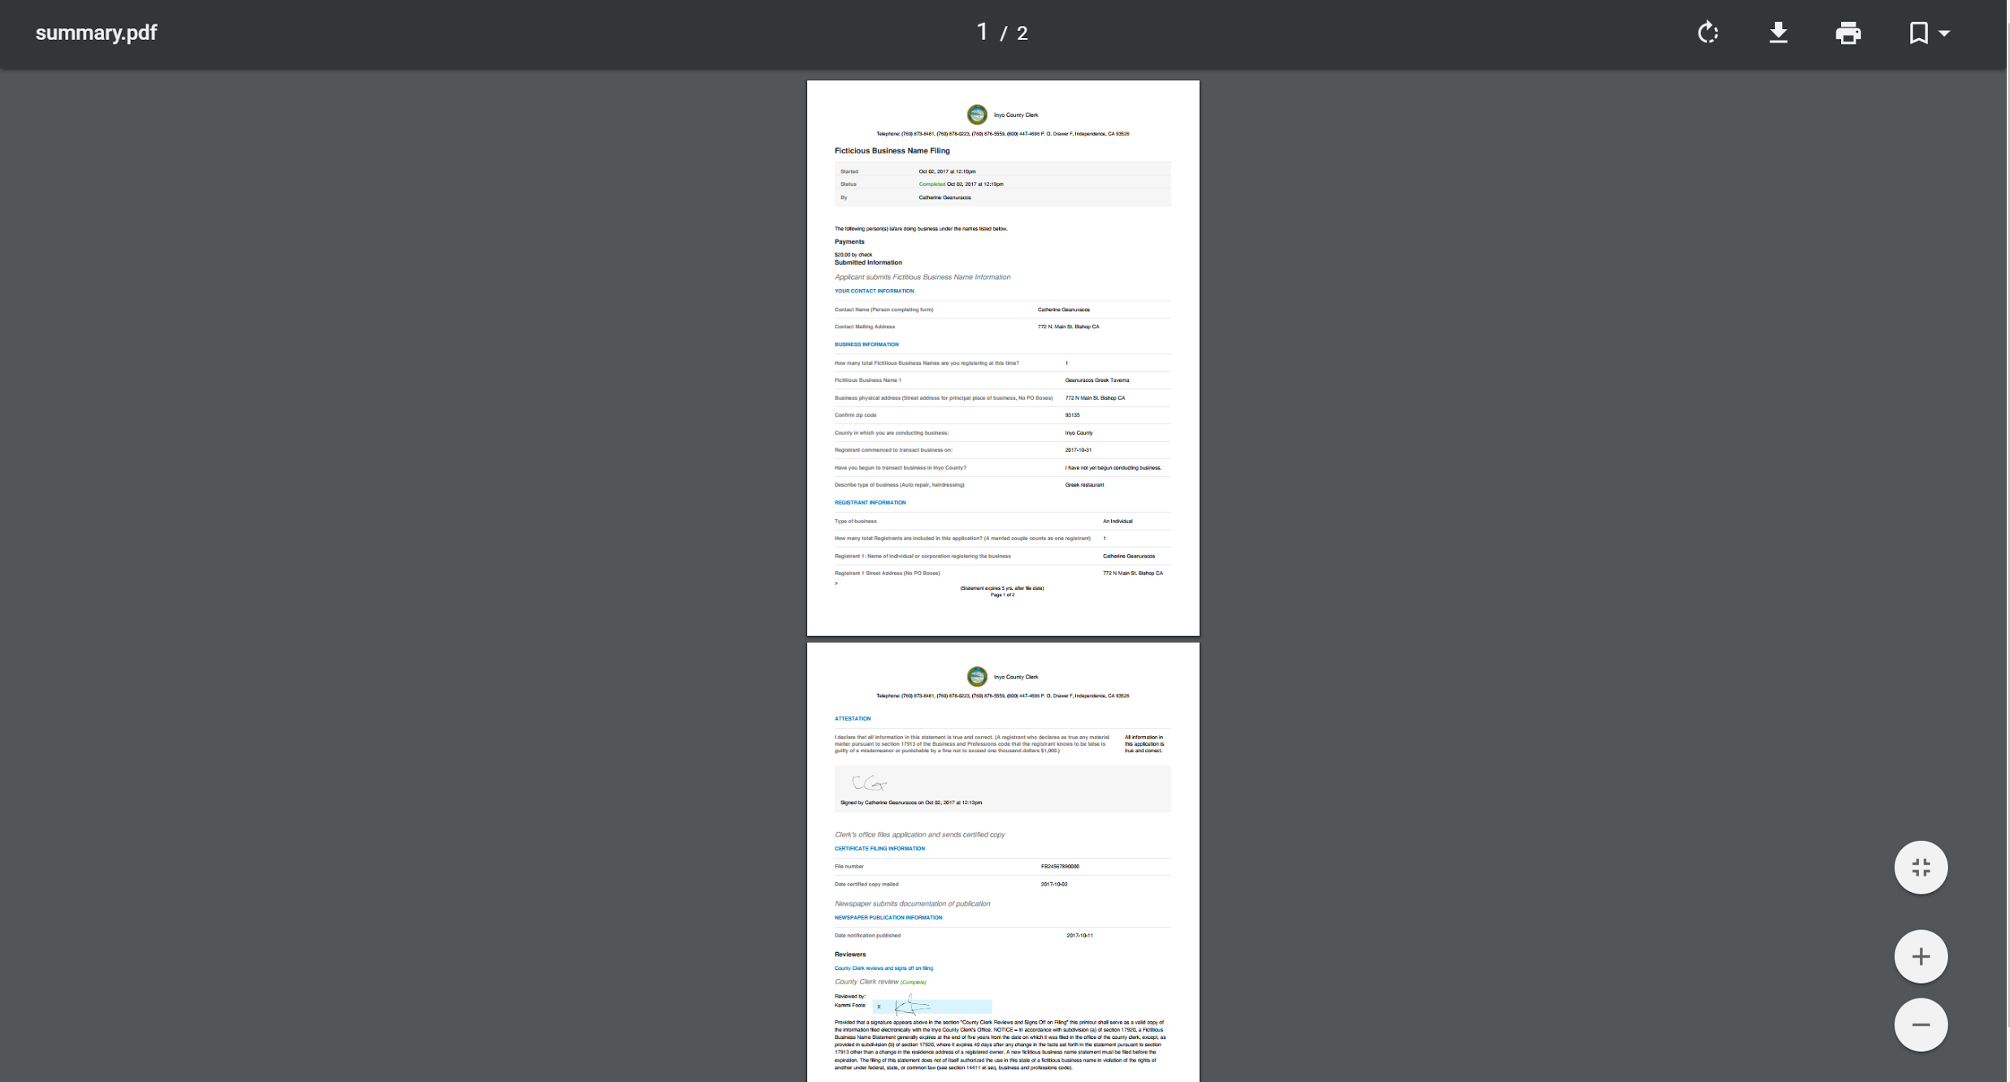
PDF download

Slide 14
Mapping

Slide 15
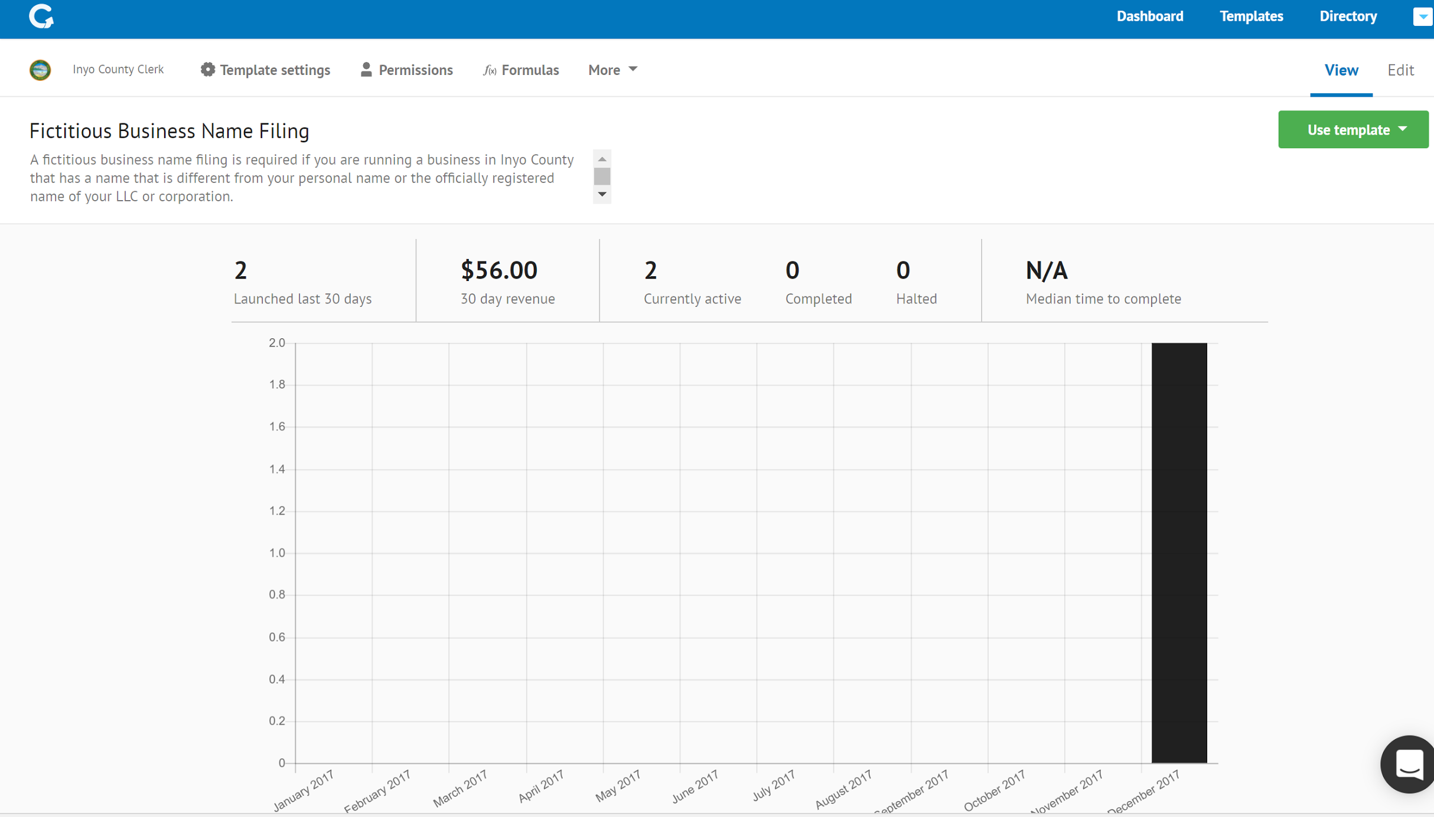
Performance Management

Slide 16
Data/Reports

Slide 17
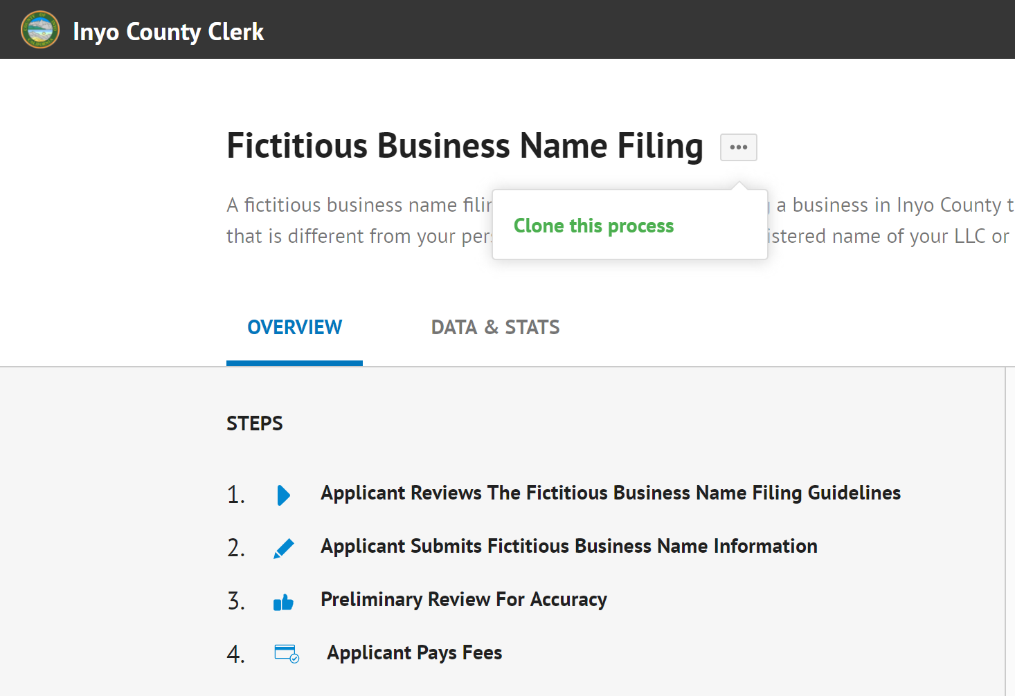
Available to be “cloned” and implemented statewide

Slide 18
Questions?
Inyo County Clerk, Kammi Foote, kfoote@inyocounty.us (760) 878-0224
CityGrows, Catherine Geanuracos, catherine@citygro.ws (415)235-7240

